Slide 1

Project Title - Seasonal Agriculture Performance Analysis
Student Name – Samprada Das
College Name- St. Thomas’ College of Engineering & Technology
AICTE STU ID : STU6976eb81373e31769401217

Slide 2

PROBLEM STATEMENT
Agricultural activities are influenced by seasonal variations in environmental conditions, farming practices, resource availability and market conditions. As a result, agricultural performance may differ from one season to another.
However, raw agricultural data does not clearly explain how agricultural performance changes across seasons or what patterns can be observed in different seasonal conditions.
The problem is to analyze the given agricultural dataset and investigate seasonal differences in agricultural performance by identifying meaningful patterns, trends, relationships and variations within the available data.

Slide 3
PROJECT DESCRIPTION
This project implements an exploratory data analysis (EDA) framework on a comprehensive agricultural performance dataset comprising 4,000 records and 28 variables.
It systematically cleans, processes, and investigates the impact of diverse environmental factors (such as rainfall, temperature, soil pH, and moisture) and operational inputs (like fertilizers, irrigation methods, and seed quality) across various seasonal conditions.
By analyzing performance metrics including crop yield, production volume, total costs, revenues, and net profits, the project uncovers data-backed insights to assist agricultural planning and resource allocation.

Slide 4

WHO ARE THE END USERS?
Farmers and Agricultural Practitioners: To help optimize crop choices, manage seasonal resource inputs, and maximize profitability.
Agricultural Planners and Policymakers: To evaluate regional performance variations and develop sustainable, data-driven farming strategies.
Agri-Tech Analysts and Researchers: To study the correlation between environmental conditions and crop yield outcomes.

Slide 5

TECHNOLOGY USED
Programming Language: Python
Data Manipulation & Analysis Libraries: Pandas, NumPy
Data Visualization Libraries: Matplotlib, Seaborn
Development Environment: Jupyter Notebook / Google Colab
Version Control: Git and GitHub

Slide 6
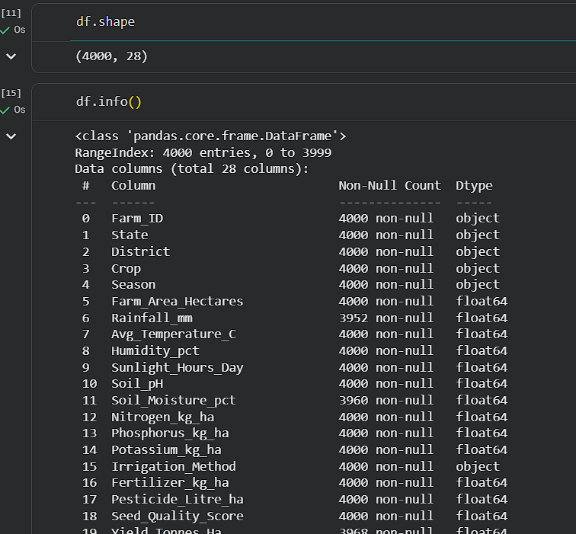
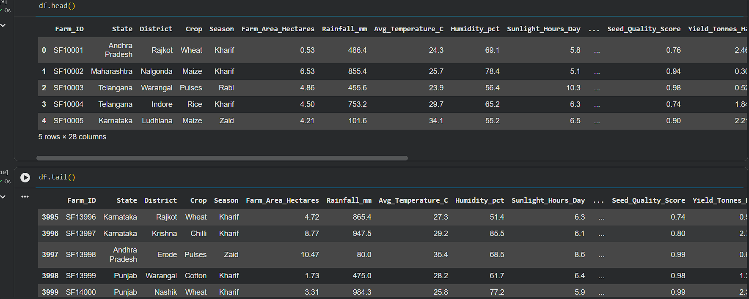
RESULTS
Dataset Inspection: Loaded and analyzed data dimensions (4,000 rows $×$28 columns), executing initial checks via df.head(), df.tail(), and df.info().

Slide 7
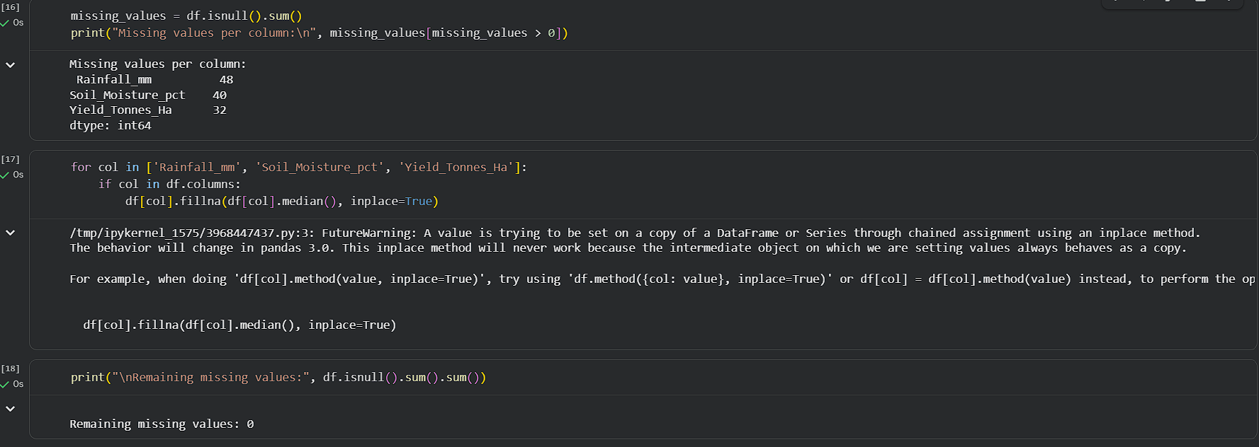
RESULTS
Data Cleaning: Identified and imputed missing values in critical attributes using median values, confirming zero duplicate entries.

Slide 8
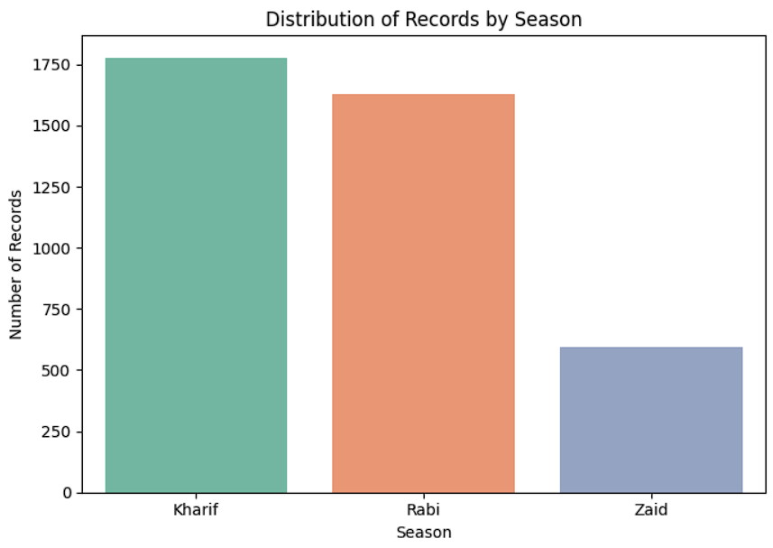
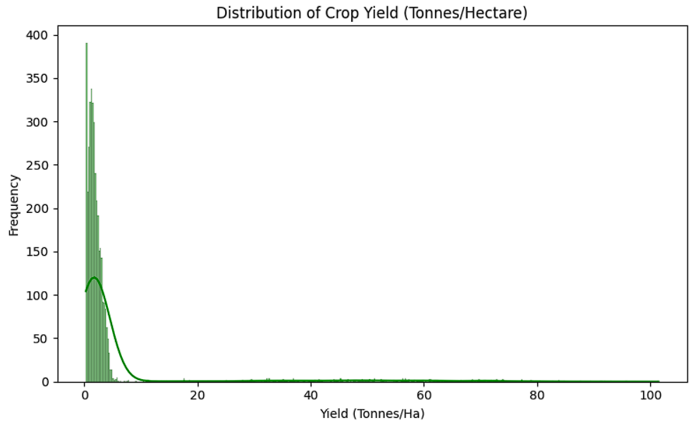
RESULTS
Univariate & Bivariate Patterns: Analyzed categorical distributions across seasons and generated statistical summaries highlighting variable ranges and metrics.
Performance Insights: Evaluated relationships between environmental inputs (rainfall, temperature, and fertilizers) and output metrics like crop yield and financial profitability.

Slide 9
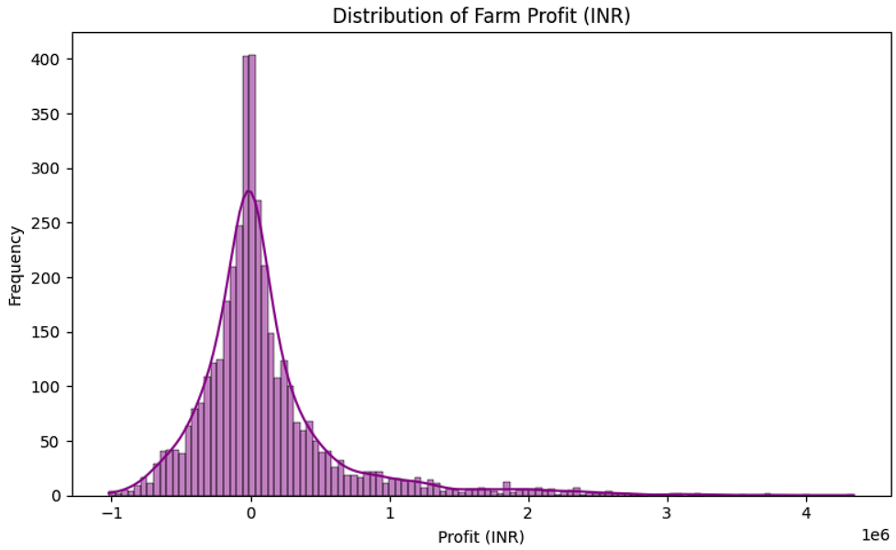
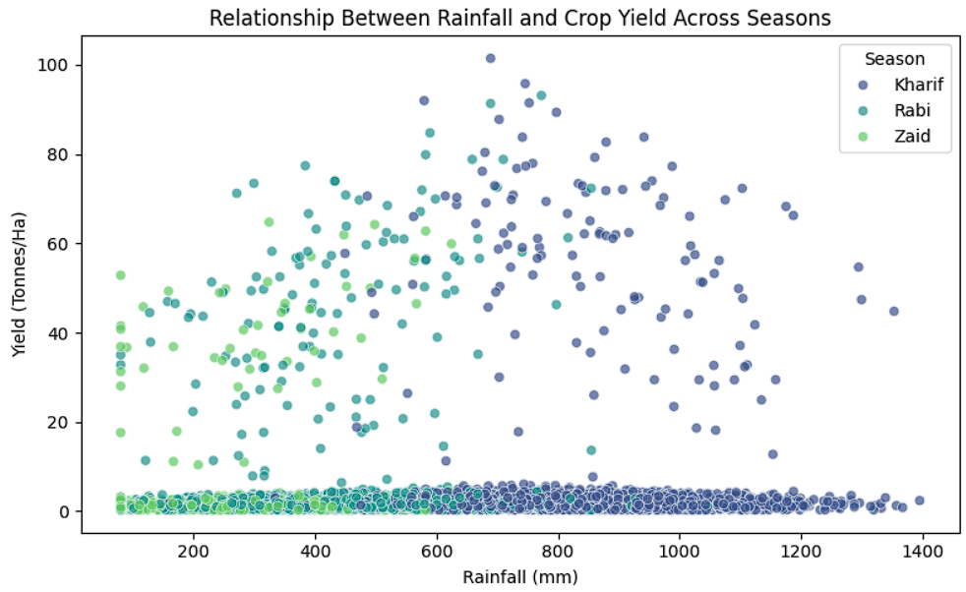
RESULTS
Identified significant performance and yield variations driven by seasonal environmental shifts and irrigation methods.
Highlighted specific financial risks, noting cost-to-profit discrepancies and loss-making operational parameters captured within the dataset's minimum profit margins.

Slide 10
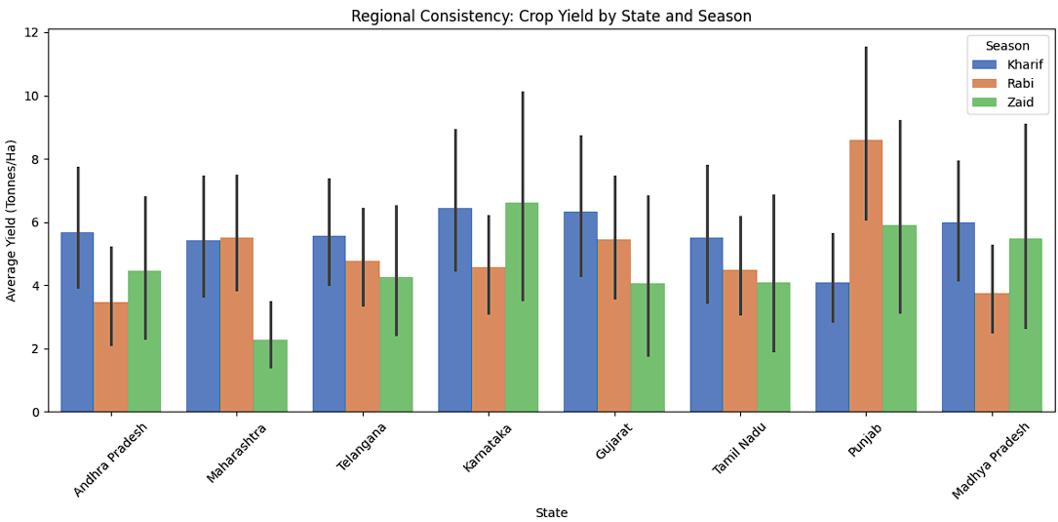
RESULTS

Slide 11
FUTURE SCOPE
Predictive Machine Learning Integration: Develop robust regression and classification models to forecast future crop yields, production volumes, and financial returns based on shifting seasonal weather patterns.
Interactive Decision-Support Dashboard: Build a real-time web application (such as a Streamlit interface) enabling farmers to input specific soil, climate, and operational parameters for instant, data-driven recommendations.
Expanded Regional Datasets: Incorporate multi-year historical data across additional states and districts to enhance model generalization and climate-resilient farming strategies.

Slide 12
Github Link
https://github.com/sampradadas10/Major-Project-Seasonal-Agriculture-Performance-Analysis.git

Slide 13

VOIS Course completion certificate – Course name- Data Visualization

Slide 14
Thank you
.
.

